Slide 1

CSET 150
Network Design and Management
Evening Masters Edition
Dr. Mahboob Qaosar
Associate Professor, CSE, RU
Week # 2

Slide 2
Chapter 2: Switching Design
Old Days – LAN –
small geographical area
Small number of devices
HUB – layer1 of OSI model was good enough
All devices were in same collision domain
1
3
HUB
2
4

Slide 3
Chapter 2: Switching Design
Layer2 switching
Multiple collision domain
The heart – MAC Address Table - CAM (Content Addressable memory)
MAC – Media Access Control
48 bit address given by manufacturer of network devices.

Slide 4
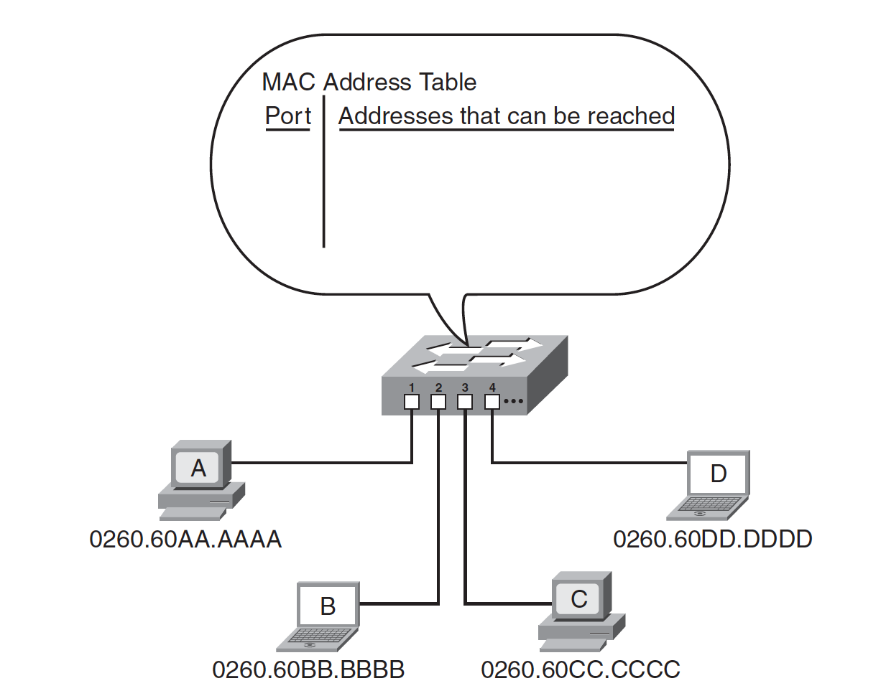
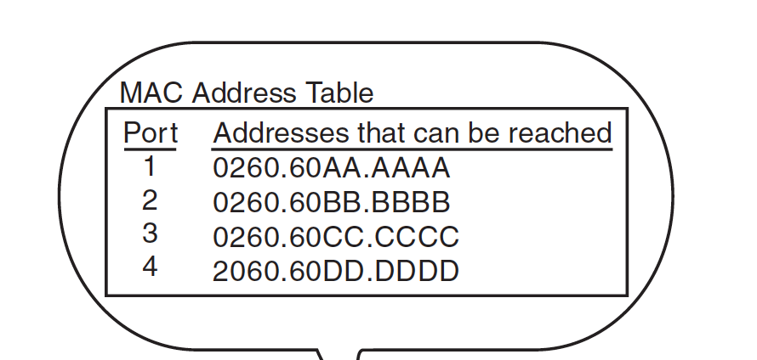
Switching Design
Learning Process
Filtering Process
Source IP | Destination IP | Other Info.
Source MAC | Destination Mac | Other Info.
A wants to Send D
A creates a frame for D
Layer 2 – Source and destination MAC Address
Sends the frame
Frame received @ port1
1st time switch’s MAC table empty – it forwards to all ports.
Only D response – Hence the switch learn about MAC of port 4

Slide 5
Switching Design
The MAC address table is kept in the switch’s memory and has a finite size
The Cisco Catalyst 2950 switch defaults to a 300-second timeout.

Slide 6
Switching Design
Layer 3 Switching:
… is really a router with some of the functions implemented in hardware to improve performance.
In other words, some of the OSI model network layer routing functions are performed in high-performance ASICs rather than in software.

Slide 8
Learning routes and keeping the best path to each destination in a routing table.
Determining the best path that each packet should take to get to its destination, by comparing the destination address to the routing table.

Slide 9
Sending the packet out of the appropriate interface, along the best path. This is also called switching the packet, because the packet is encapsulated in a new frame, with the appropriate framing header information, including MAC addresses.

Slide 10
Communicating with other routers to exchange routing information.
Allowing devices on different LANs to communicate with each other and with distant devices.
Blocking broadcasts.

Slide 11
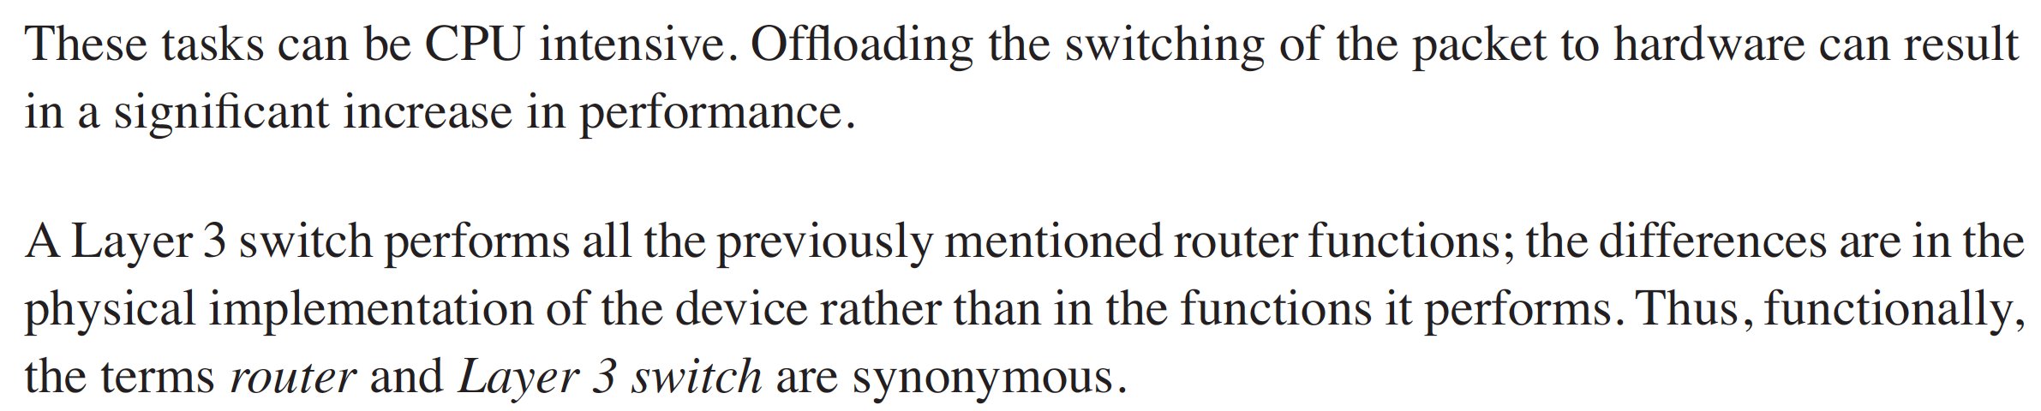
Switching Design

Slide 12
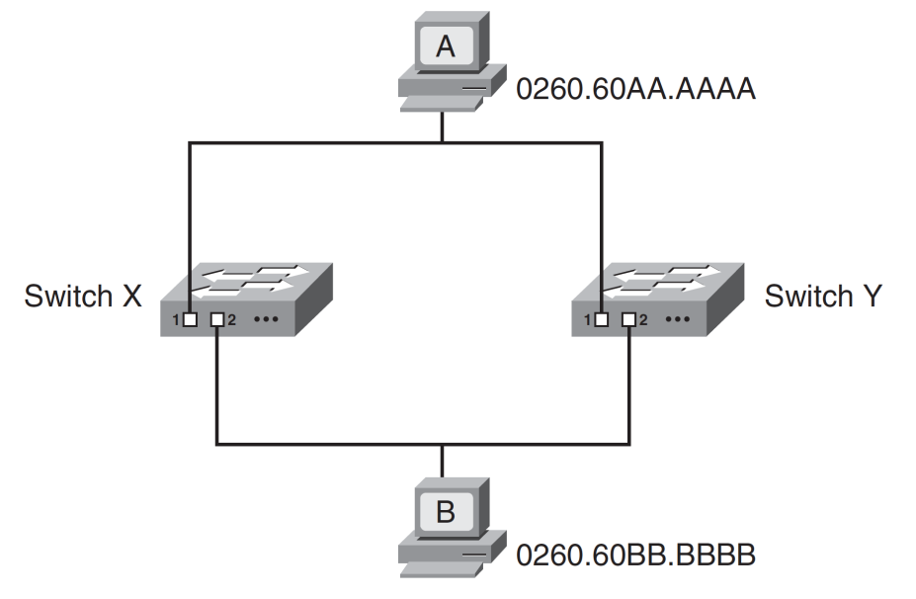
Spanning Tree Protocol (STP)
STP is a Layer 2 protocol that prevents logical loops in switched networks that have redundant links
Redundancy in a network
.. so that communication can still take place if a link or device fails.
However, in a switched network, redundancy can cause problems.

Slide 13
Spanning Tree Protocol (STP)
Problems:
The first type of problem occurs if a broadcast frame is sent on the network.
ARP: Address Resolution Protocol
The broadcast continues to loop around the network, consuming bandwidth and processing power.
This situation is called a broadcast storm.

Slide 14
Spanning Tree Protocol (STP)
The second problem that can occur in redundant topologies is that devices can receive multiple copies of the same frame.
This might be a problem for device B, depending on what it is and how it is programmed to handle such a situation

Slide 15
Spanning Tree Protocol (STP)
The third difficulty that can occur in a redundant situation is within the switch itself the MAC address table can change rapidly and contain wrong information.

Slide 16
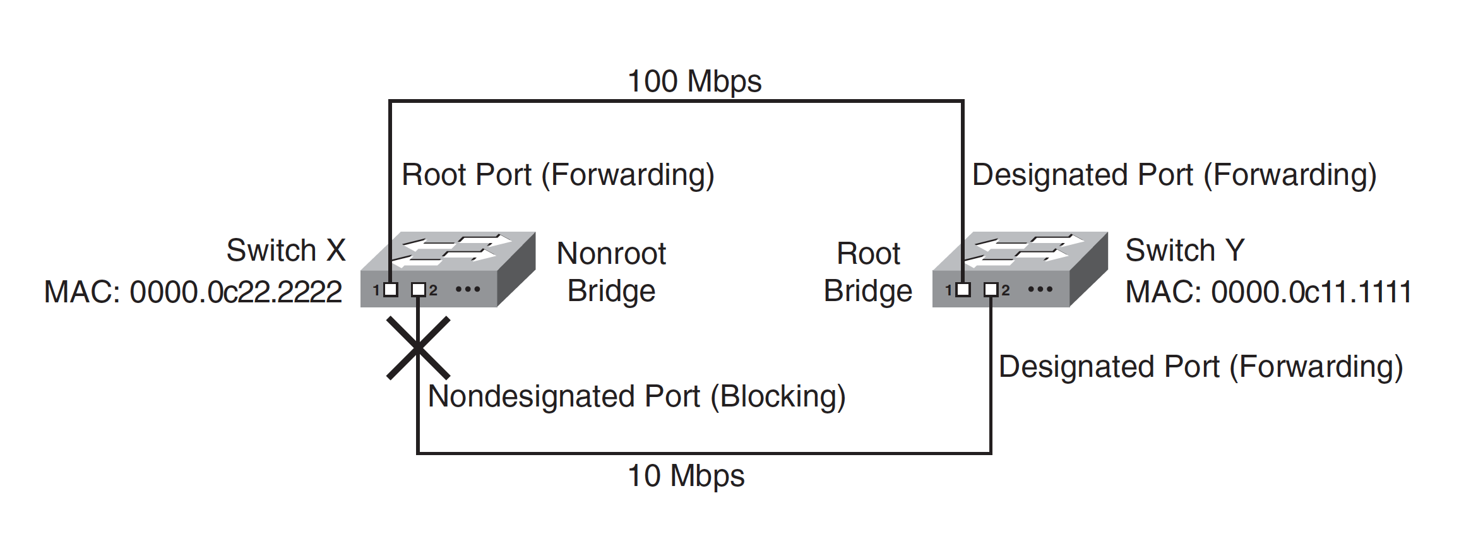
Spanning Tree Protocol (STP)

Slide 17
Spanning Tree Protocol (STP)
One switch is elected as the root bridge it is at the root of the spanning tree.
All other switches calculate their best path to the root bridge.
Their alternate paths are put in the blocking state.
These alternate paths are logically disabled from the perspective of regular traffic, but the switches still communicate with each other on these paths so that the alternate paths can be unblocked in case an error occurs on the best path.

Slide 18

Spanning Tree Protocol (STP)
All switches running STP send out bridge protocol data units (BPDUs)
Switches running STP use BPDUs to exchange information with neighboring switches.
One of the fields in the BPDU is the bridge identifier (ID);
it is comprised of a 2-octet bridge priority and a 6-octet MAC address.
STP uses the bridge ID to elect the root bridge the switch with the lowest bridge ID is the root bridge.
If all bridge priorities are left at their default values, the switch with the lowest MAC address therefore becomes the root bridge.
switch Y is elected as the root bridge.

Slide 19
Spanning Tree Protocol (STP)
All the ports on the root bridge are called designated ports,
They are all in the forwarding state → can send and receive data.
On all non-root bridges
One port becomes the root port, and it is also in the forwarding state.
The root port is the one with the lowest cost to the root.
The cost of each link is by default inversely proportional to the bandwidth of the link, so the port with the fastest total path from the switch to the root bridge is selected as the root port on that switch.
Port 1 on switch X is the root port for that switch because it is the fastest way to the root bridge.

Slide 20

Spanning Tree Protocol (STP)
All ports on a LAN segment that are not root ports or designated ports are called nondesignated ports and transition to the blocking state
they do not send data, so the redundant topology is logically disabled, port 2 on switch X is the nondesignated port, and it is in the blocking state.
Blocking ports do, however, listen for BPDUs.

Slide 21
Spanning Tree Protocol (STP)
If a failure happens
if a designated port or a root bridge fails
the switches send topology change BPDUs and recalculate the spanning tree.
The new spanning tree does not include the failed port or switch, and the ports that were previously blocking might now be in the forwarding state.

